Slide 1

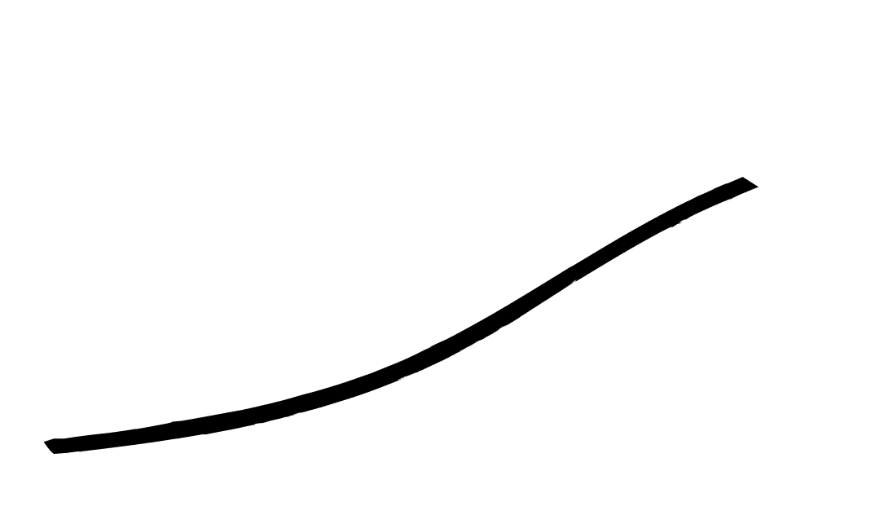

E-Commerce Analytics
Balaji M
Lavina Correa
Nikhil Verma
Niranjay Singh
Priya Sharma

Slide 2

Table of Content/Index
Project Objective 3
Introduction to RFM Segmentation 4
Data Information/Analysis 5
Pre-Processing – Data Cleaning 6
EDA -Relationship between variables 10
Defining RFM 15
Calculating RFM 16
RFM DataFrame 17
Exploring RFM DataFrame 18
Pre and Post Log Transformation Graphs 19
Exploring Standardized Data 20
Elbow Graph 22
Evaluation 23
Clusters Analysis 24
Silhouette Visualizer 25
3D Plots 26
Hierarchical Clustering 27
Recommendations 28
Summary 29

Slide 3


Project Objective
To build an unsupervised Machine Learning model which can enable the company to analyze the customers via RFM (Recency, Frequency and Monetary value) approach.
To enable the company to optimize their retention and acquisition strategies.
To achieve the above two objectives, we have done extensive EDA.
We have built two Unsupervised Machine Learning Models: KMeans and Hierarchical.
To evaluate our models we have used Silhouette Score as our evaluation metric.

Slide 4

RFM Segmentation in E-Commerce
RFM analysis for customer segmentation is highly significant in retail E-Commerce, where RFM stands for Recency, Frequency, and Monetary Value.
Advantages of RFM
Opportunity to target valuable customers to double the revenue.
Plays a significant role in determining the relation of a customer with the company.
Attract customers by realizing their needs.
Increase customer engagement by giving custom product suggestions

Slide 5

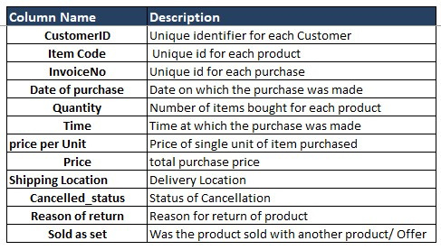
Data Information/Analysis
Listed below in the table is information of Raw Data that is used for this project.
There are 4349 unique CustomerID Values
Raw Data has 537979 Rows and 12 Columns

Slide 6

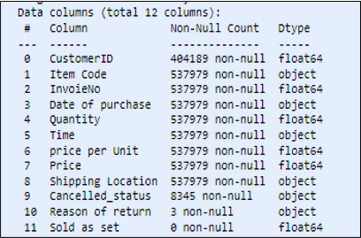
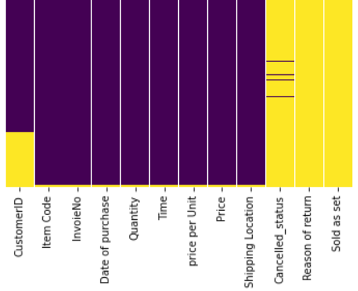
Pre-Processing – Data Cleaning
We have explored the data by checking NaNs and data types using the Info method and the Heatmap below.
We have removed columns “Sold as Set” & “Reason of Return” as the former is 100% NaNs and the latter is 99.99% NaNs.

Slide 7
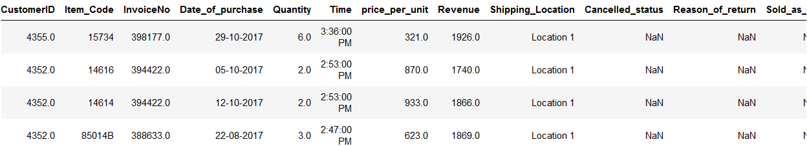
Pre-Processing – Data Cleaning
STEP 1 – Renaming Columns
Renaming columns by separating the spaces between them with underscores and correcting the spelling of InvoiceNo. for our convenience.

Slide 8
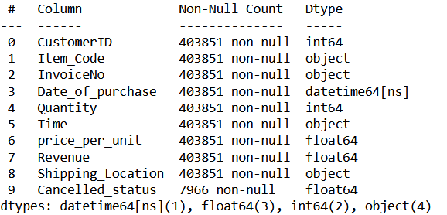
Pre-Processing – Data Cleaning
STEP 2 – Correcting Data Types, Removing Duplicate Rows and Deleting rows in CustomerID field where sum of Revenue is <=0
We have changed Date_of_purchase to datetime64[ns] from object dtype and CustomerID dtype to int64

Slide 9

Pre-Processing – Data Cleaning
STEP 3 – Treating NaN values
25.3% of the records are NaNs in CustomerID column. We have dropped these values because imputing them with mean/median will show biasness towards the imputed CustomerID.
The CustomerID column is supposed to be unique so it will be wrong to impute them.
We have also dropped the NaNs for InvoiceNo as it is a unique identifier along with NaN records in other columns.
Later, we dropped columns : 'Item_Code’, 'Quantity’, 'Time’, 'price_per_unit’, 'Shipping_Location’, 'Cancelled_status’ because they served little to no purpose for RFM analysis and the ultimate model building.
Removed 8 duplicated rows and Deleted rows of CustomerIDs with sum of Revenue <=0.
Shape after pre-processing the data.

Slide 10
Exploratory Data Analysis on the Dropped Features As well as the features Important for our Models
RFM Dropped Features Used for EDA:
Item_Code
Time
Shipping_Location
Cancelled_status
Features important for RFM Analysis Used for EDA Are:
CustomerID
Date_of_purchase

Slide 11

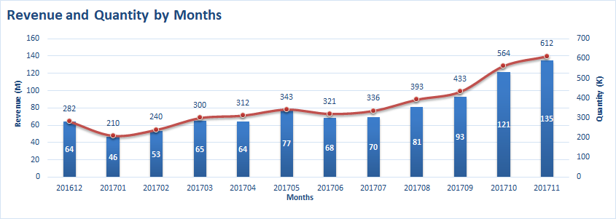
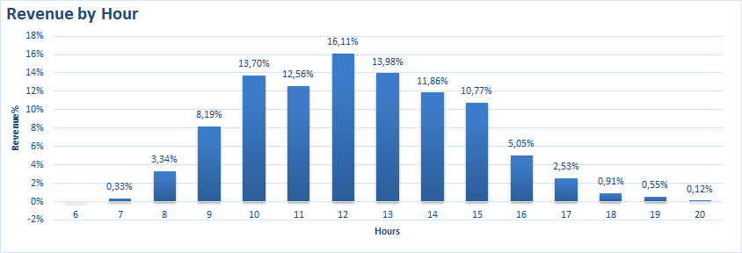
EDA - Relationship between variables
Monthly Revenue distribution between Dec 16’ to Nov 17’
A rising trend in Quantity and Revenue can be seen over the given period
Revenue Distribution by Time slots
10 AM to 2 PM are peak hours for sale accounting for 2/3rd of total sales
None to very less sales happen between 6:00PM to 8:00 AM. To improve sales promotional strategies like discounts/offers are recommended to enhance sales during this period

Slide 12
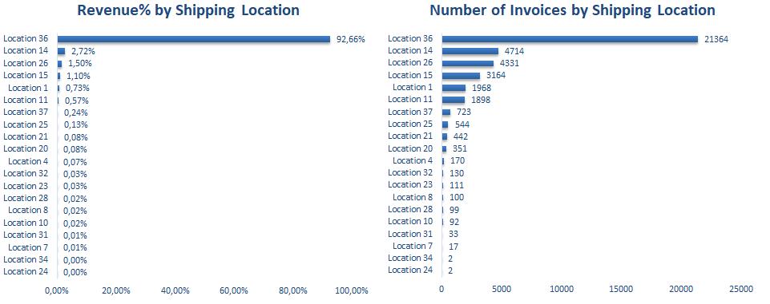
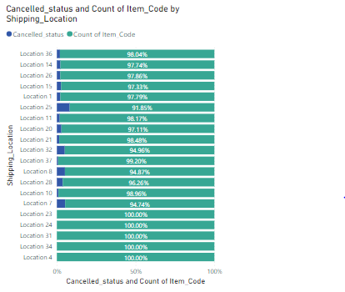
EDA - Relationship between variables
Shipping_Location
Maximum Revenue by number of Invoices and Value is shipped by Location 36, load sharing or consolidation can be considered with respect to location.
Location 25 has 8% Cancellation, need further analysis if the cancellation are due to delay in delivery, breakage, packaging, etc.

Slide 13
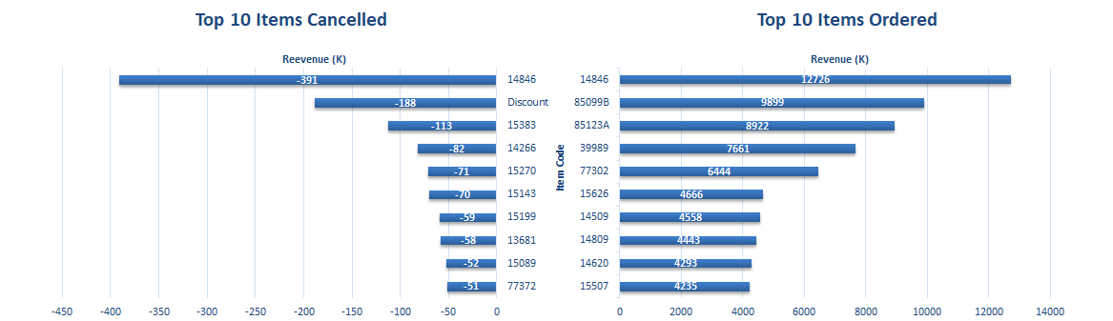
EDA - Relationship between variables
Item_Code
Item 14846 generated most sales and most cancellation
Item Code Discount is the second most in terms of cancellation and has cancellation for all transactions implying the Cancellation Status is 1 sometimes to show discount.

Slide 14
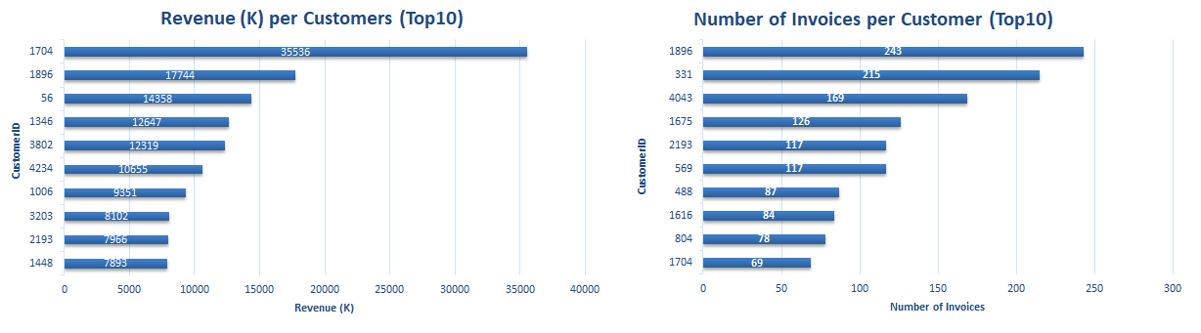
EDA - Relationship between variables
CustomerID
Customer 1704 has ordered the most with respect to Revenue and deals in high value transactions.
Customer 1896 is the most frequent buyer and is second most with respect to Revenue
Majority of Customers (70%) have ordered more than once

Slide 15
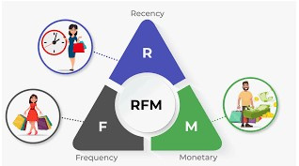
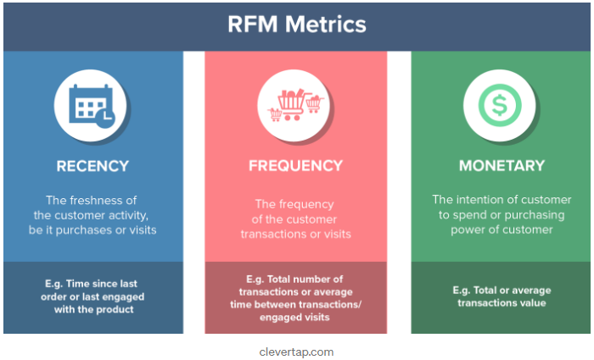
Defining RFM
Recency: How recently has the customer made a transaction with the company.
Frequency: How frequent is the customer in ordering/buying some product from the company.
Monetary: How much does the customer spends on purchasing products from the company.

Slide 16
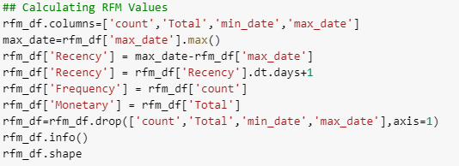
Calculation of RFM
Recency Value
Recency is difference of days in the cutoff date of data and last purchase date of Customer. According to our data the Last Purchasing Date (max Date) is December 19 2017 so cut off date will be December 20 2017.
Frequency Value
Frequency is Number of Invoices for Customer.
Monetary Value
Monetary is total sales for Customer.

Slide 17
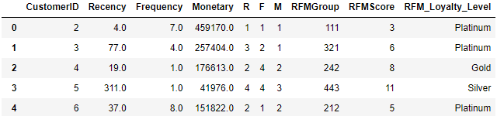

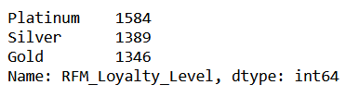

RFM DataFrame
We have done RFM Scoring and Loyalty Level Grading on the basis of Quantile-Quartile method.
Out of 4349 unique CustomerID rows 30 rows with negative values are removed from RFM Data frame as it may affect RFM analysis
Distribution of Levels
Shape of rfm_df
Interpretation of levels:
Platinum - Most loyal and best customers
Gold - Very good customers and signification contributors to the business
Silver - Irregular customers

Slide 18

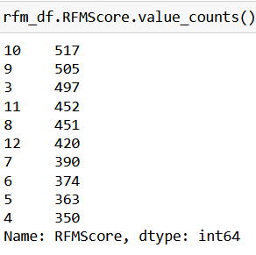
Exploring RFM DataFrame
Max and Min RFMScore
Maximum RFMScore is 12
Minimum RFMScore is 3
Value Counts and Unique Values in RFMScore as well as the count of RFM_Loyalty_Level
Finding median, mean and mode in RFMScore
Median: 8
Mean: 7.64
Mode: 10

Slide 19
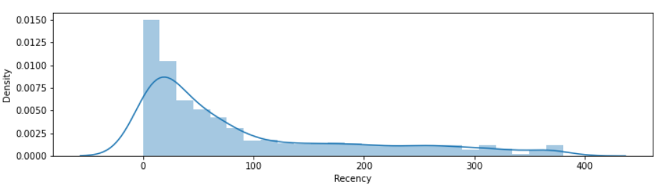
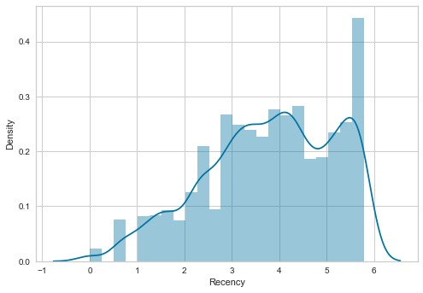
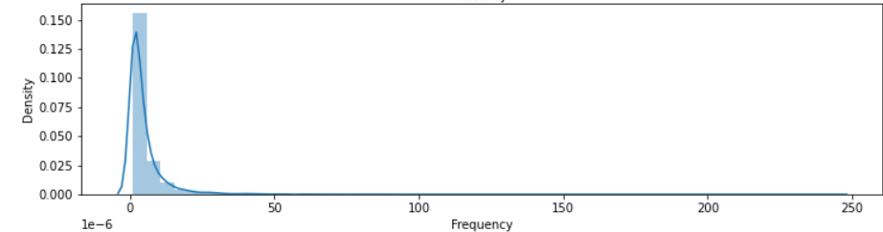
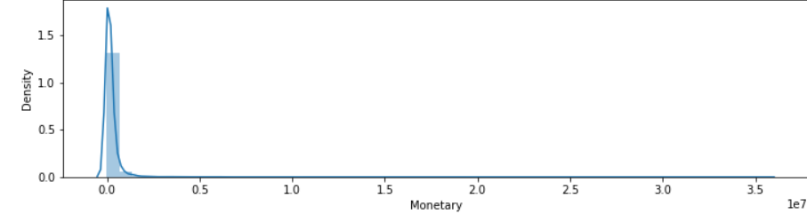
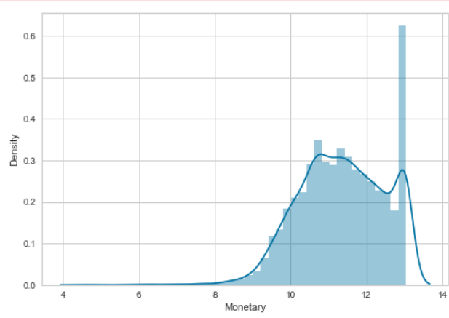
Pre and Post Log Transformation Graphs
Positively/Rightwards skewed
Post Log transformation
We have also corrected the outliers in R, F, M using Quantile formula.

Slide 20
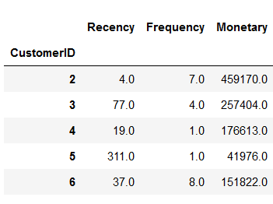
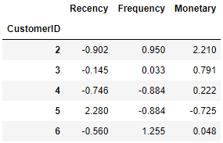


Exploring Data Post Standardization
We have standardized the data using StandardScaler to bring down all the features to a common scale without distorting the differences in the range of the values.
Unscaled Data
Scaled Data
Shape of the Standardized Data
The min and max values for each show that our data has been scaled

Slide 21

Machine Learning
KMeans Clustering
Silhouette Score
Hierarchical Clustering

Slide 22
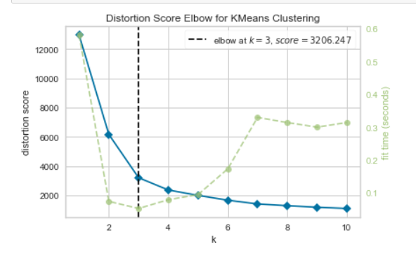
K Means Cluster identification using Elbow Method
The Elbow Method is one of the most popular methods to determine the optimal value of K
Here, we have tried to plot the cluster numbers on the x-axis and their respective score on the y-axis
By observing the graph, using the elbow method, dividing the clusters into 3 gives proper results as the bent is falling between 2 and 4

Slide 23
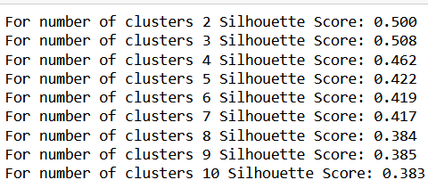
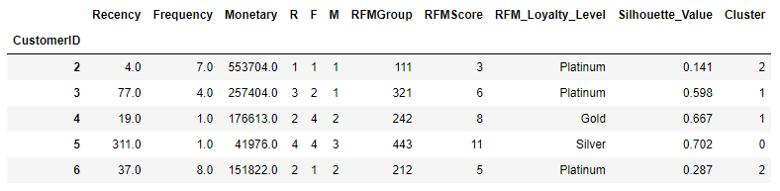
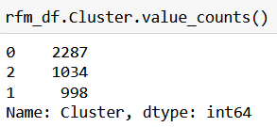
Cluster Evaluation
Looping method to choose K with highest Silhouette Score
rfm_df with Cluster and Silhouette_Value
Overall Silhouette Score with K = 3
Parameters that went inside the model building process.
Cluster Distribution.
Silhouette Score reached optimum value at 0.508 for numbers of clusters as 3
Cluster 0 has maximum numbers of customers (2287) and Cluster 1 has least number of customers (998)

Slide 24
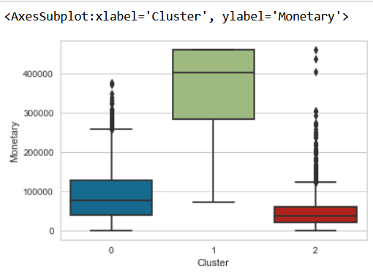
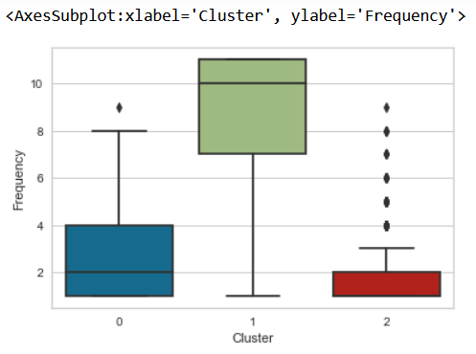
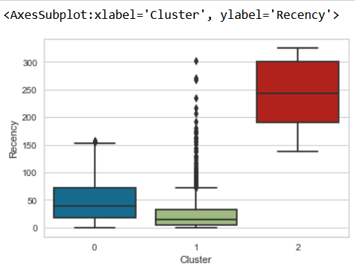
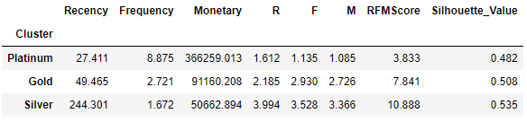
Post K-Means Cluster Analysis
Cluster 1 spends highest and cluster 2 spends lowest.
Cluster 1 buys often and cluster 2 buys less often.
Cluster 1 has made recent purchase while cluster 2 has old transactions.
Observing the customer’s spending behaviour from box plots above, we can label Cluster 1 as Platinum, Cluster 0 as Gold, and Cluster 2 as Silver

Slide 25
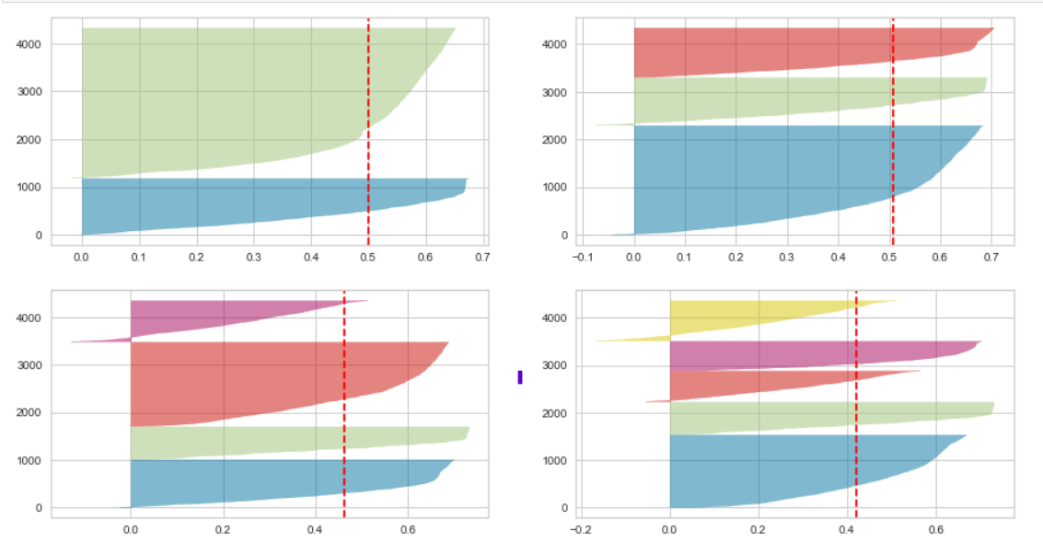
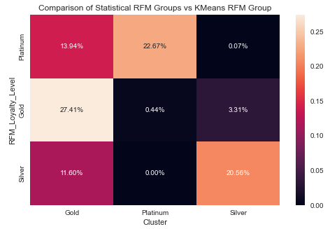
Silhouette Visualizer and Cross Validation
The above Silhouette analysis is done to select an optimal value for n_clusters.
The value of n_clusters as 4 and 5 looks to be suboptimal for the given data.
The value of 2 and 3 for n_clusters looks to be optimal.
The Silhouette Score for each cluster is above average.
The thickness of the silhouette plot is also a deciding point for n_cluster selection.
For plot with n_cluster 3 (top right), the thickness is more uniform than the plot with n_cluster as 2 (top left) with one cluster thickness much more than the other. Thus, one can select the optimal number of clusters as 3.
Comparison of Statistical RFM Groups vs KMeans RFM Group
Interpretation:
The range of Silhouette Score is between -1 to 1, anything closer to 1 means that the data point is very compact within the cluster to which it belongs and far away from the other clusters, while values near -1 denote overlapping clusters.

Slide 26
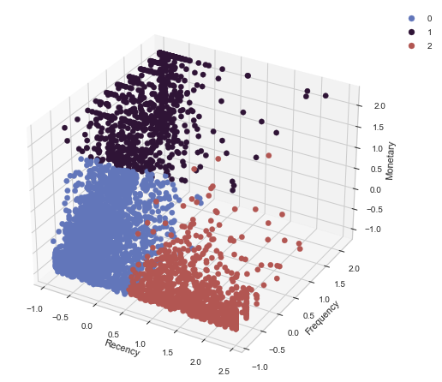
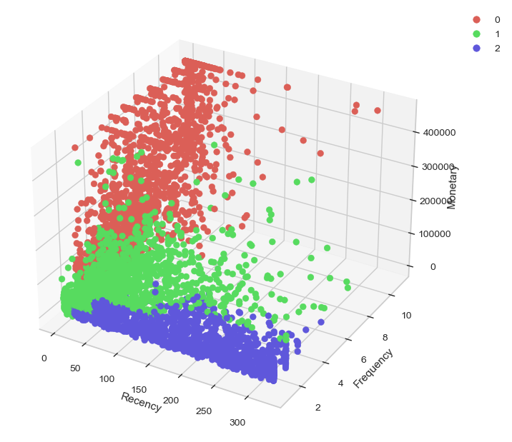
Statistical RFM Clusters VS KMeans Clusters
Gold
Platinum
Silver
Platinum
Gold
Silver
Scaled Values
The above graph is a visualization of the segmented groups showing the values of Recency, Frequency and Monetary values of people based on which they can be categorized on
‘who needs attention’(Silver),
’ who have potential’(Gold)
top buyers(Platinum)
The graph is difficult to comprehend due to skewed data, non uniform scaling and overlapping of groups
This a 3D representation of all the segmented customers. From this plot, we can see
group who are frequent buyers and have done recent purchases which were of very high value (Platinum group)
groups of people who have visited recently, but are less frequent buyer and purchase of lesser value when compared to Platinum Group (Gold group)
groups with old purchases, less frequent and in less value (Silver)

Slide 27
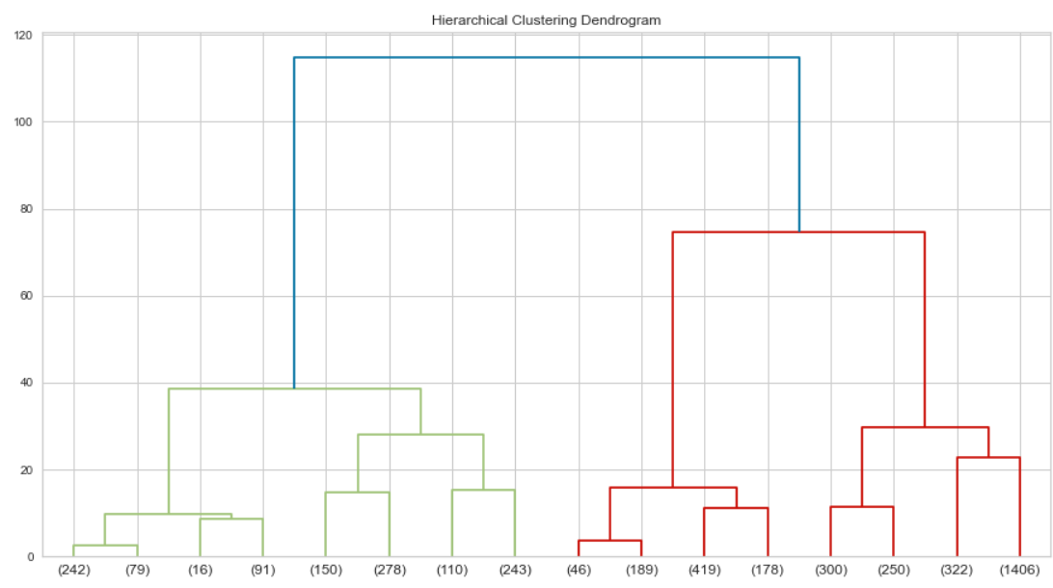


Hierarchical Clustering
Dendrogram
Overall Silhouette Score
Cluster Distribution.
The above visualization depicts a dendrogram that explains the relationship between all the data points in the system.
The Silhouette Score of 0.48 for number of cluster as 3 is lesser when compared to K Means Clustering.
The dendrogram above shows 3 clear levels of distinction.

Slide 28
Recommendations
Clustering:
Platinum Group are the most valuable customers for us, most visiting recently, frequently, and have highest total purchase for transaction. Reward is a must for this segmentation, discount, offers, frequent interactions, dedicated support and many more action that we can.
Gold Group, Need to focus on this group to convert these into Platinum, personalized email with offers, discounts on nonpeak hours, loyalty program are recommended
Silver Group, or the Inactive Group, We can ignore them for now.
EDA:
Either Segregation of Location to Location 36 or distribution of products to other locations.
None to very less sales happen between 6:00PM to 8:00 AM, promotional strategies like discounts/offers are recommended to enhance sales during this period.
Discounts should have column instead of clubbing them in Item code.
Capacity Planning for Increasing Revenue trend.

Slide 29
Summary
What we have done:
We have built a KMeans Clustering model in order to segment customers on the basis of RFM approach.
We have chosen Silhouette Score as our evaluation metric.
We have made several Diagnostic plots to help us determine how well our model is performing.
The Silhouette Score for KMeans is 0.508
We have also built a Hierarchical Clustering model to check which model gives us the better score.
The Silhouette Score for Hierarchical Clustering is 0.483.
Since the Silhouette Score for KMeans is more, we suggest to go ahead with the KMeans model as it is performing better.
Recommendation on Segmentation, Shipping Locations, Time, Revenue and Discounts

Slide 30
THANK YOU!

